Slide 1
Variant Filtering
GATK Best Practices for Variant Discovery
Assigning accurate confidence scores to each putative mutation call
Notes:
Earlier we did BQSR and we’re doing the same thing here in that we’re going to be using models of the data to correct the data. Works best for multi-sample data with lots of variants.
After we call variants with HP Caller

Slide 2
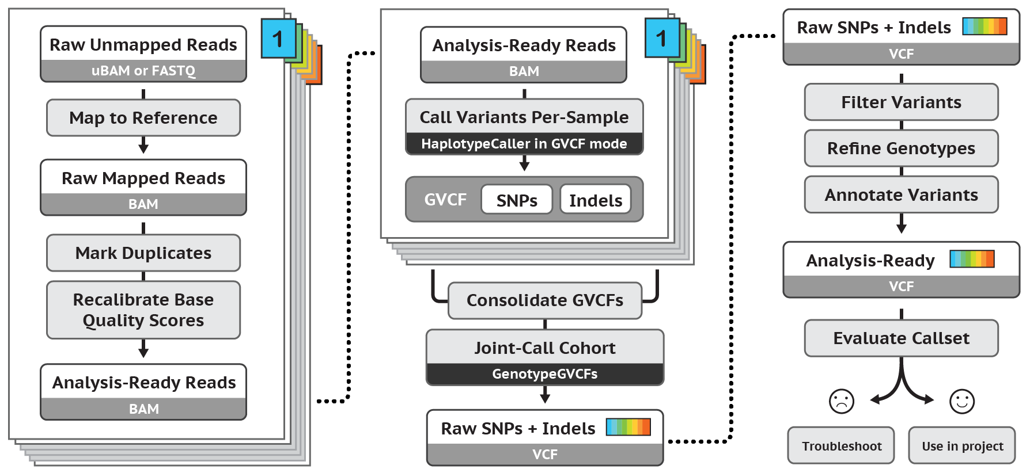
Best Practices for Germline SNP & INDEL Discovery
Notes:
Want to refine callset to adjust for sensitivity of precision that we want for our task given the data that we have.

Slide 3
Filtering VCFs to Balance Sensitivity and Specificity
Variant calling algorithms are very permissive by design
Raw, high-sensitivity callsets contain many false positives
Three filtering approaches
Hard-filters using binary thresholds
Applicable to all BUT requires hand-tuning to define appropriately
Variant “recalibration” with Gaussian Mixture Models
Requires well-curated resources, uses variant context annotations
Variant “recalibration” with Convolutional Neural Networks
Requires well-curated resources, uses reference context, variant annotations, and raw reads
Filtering always entails a trade-off between sensitivity and specificity
Notes:
HC permits many variants in order to have high sensitivity in the discovery phase. Leads to big call sets with a lot of false positives. Some of those variants will turn out to be artifactsl and should be excluded from subsequent analysis. Old way was to filter by hand, which involved looking at a lot of data and going through several iterations.
Users ask “what threshold should I use to get all the REAL variants?” but the false positives can look a lot like the true positives and they often classify similarly so we get the good with the bad. Depending on your project you may want to limit your false positives by only passing the highest confidence true positives, which may miss some true positives, or you may want a highly sensitive threshold to capture almost all of the true positives, knowing that some false positives are going to sneak in. Flexible way to move the threshold and examine the results.
Trying to build a model that’s representative of “true genetic variants” and assign each variant a quantitative score based on its likelihood of being a true positive. We can then order the variants by this score in order to take the top X percent of the best-looking variants.
---
Be as sensitive as possibke and emit as many varaints as reasonable
Then adjust per preference – high quality variants means lower your sensitivity etc.
Hard filter : numeric cutoff on a summary statistic that describes each variant
VQSR: uses gaussian mixture mode and tries to model what high quality variants look like
Neural net: looks at annotations but also at surrounding sequence context and also at raw reads to determine variant from artifact
Both bodesl require truth data so you need valudated VCFs but we have those from humans byt not all other species. So can train these models and deploy with gatk.
Sensitivity versis specifiy tradeoff always when filtering varaiants
Filter can only REDUCE specifity.

Slide 4
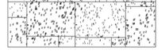
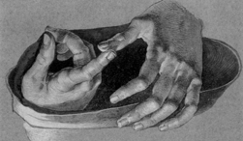
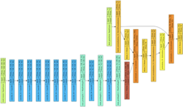
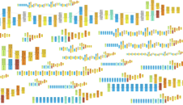
Variant Filtering History
Hand-crafted decision boundary (hard filtering)
Hand-crafted features, machine-learned decision boundary (MLP, VQSR, Random Forests, SVM)
Hand-crafted architectures, machine-learned features, machine-learned decision boundary
Machine-learned architectures, machine-learned features, machine-learned decision boundary
Notes:
(I don’t think we use strand bias anymore)
This is just a projection into 2-D space for these two variation, but the VQSR uses all the annotations that you give it.
You may be wondering “why do I have to do this for every dataset? Can’t I just use the classification rules from the first dataset on all my other projects?” Nope! Different experiments and different data have different fits, from batch effects, etc. Need to retrain every time for best results.
Need to start with high confidence variants like HapMap.
----
Only hard thresholds in the beginning. They work okay but tend to scale poorly so with a new dataset you may have to find a new threshold – doesn’t stay the same as the previous set. All the lines are straight = a cutoff. Good or Bad – a simple decision. Many annotation values we can compare but the thresholds don’t interact so they are just blocks. Its blunt and doesn’t take into account interactions.
Hand crafted features/annotations – some kind of number that describes the variant (Depth, bias etc) – machine learned the number to set that boundary instead of hand calculated
Maybe annotations don’t say everything about the variant that we want to know. Instead let the machine learning system determine what makes a good variant without choosing. Let the machine learn the FEATURES and THEN let another machine learning system decision the boundaries between good and bad.
Then machine learning the entire system. Not just the features but also the architectures. Not really here at this point.

Slide 5
Variant Context Annotations Describe the Observed Data
Each variant has a diverse set of statistics associated with it:
VCF record for an A/G SNP at 22:49582364
49582364 . A G 198.96 . AC=3; AF=0.50; AN=6; DP=87; MLEAC=3;
MLEAF=0.50;
MQ=51.31; MQ0=22; QD=2.29; SB=-31.76 GT:DP:GQ 0/1:12:99 0/1:11:89 0/1:28:37
AC | No. chromosomes carrying alt allele | MLEAF | Max likelihood AF
AN | Total no. of chromosomes | MQ | RMS MAPQ of all reads
AF | Allele frequency | MQ0 | No. of MAPQ 0 reads at locus
DP | Depth of coverage | QD | QUAL score over depth
MLEAC | Max likelihood AC
INFO field
Notes:
Stopped at 9:18 http://www.broadinstitute.org/videos/variant-quality-score-recalibration-0
DP,AC,AF,MLEAC,MLEAF,FS,SOR,InbreedingCoeff,QD
Note that this is variant site-level, not genotype-level (only info field, not any Gfields)
------
List of # that desc. The variant.
AC = # chromosomes carrying the allele
DP = depth of coverate
Strand Odds ratio = was variant seen more on one strand versis the other
Read Pos Rank Sum = was the var seen at a certain point in the read. Reads get worse towards the end of the read (sequencer gets tired or checmicals get tired)

Slide 6
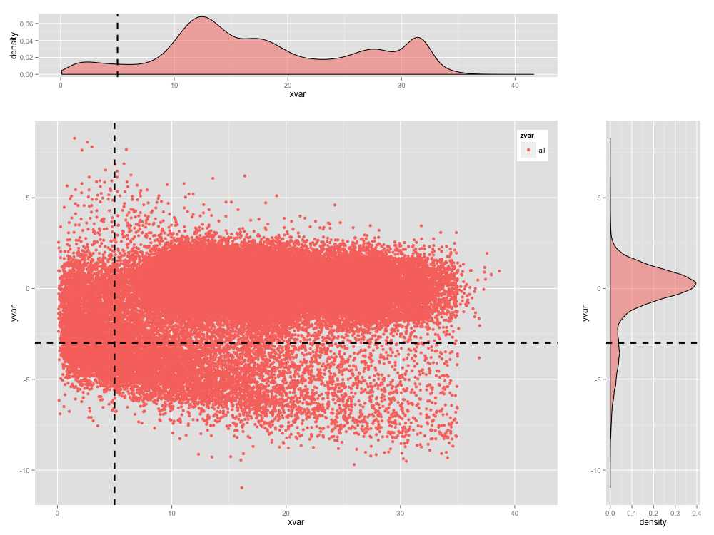
Hard Filtering is a Blunt Instrument
Notes:
Stopped at 9:18 http://www.broadinstitute.org/videos/variant-quality-score-recalibration-0
DP,AC,AF,MLEAC,MLEAF,FS,SOR,InbreedingCoeff,QD
Note that this is variant site-level, not genotype-level (only info field, not any Gfields)
----
Hard Cutoffs: Shows some annotations in a 2D space. All we can do is cut straight lines and exclude one of the quadrants.

Slide 7
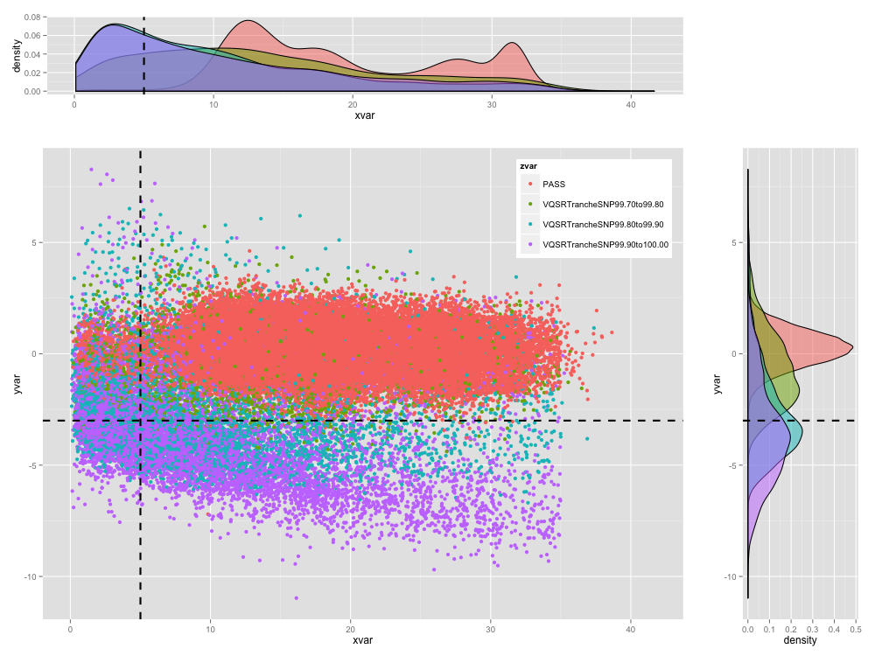
Models are Better than Thresholds
Notes:
Stopped at 9:18 http://www.broadinstitute.org/videos/variant-quality-score-recalibration-0
DP,AC,AF,MLEAC,MLEAF,FS,SOR,InbreedingCoeff,QD
Note that this is variant site-level, not genotype-level (only info field, not any Gfields)
----
More complicated decision boundary. Look at interactions between the two annotations and decide on a variants future. Look at all the evidence at once and not separately.

Slide 8
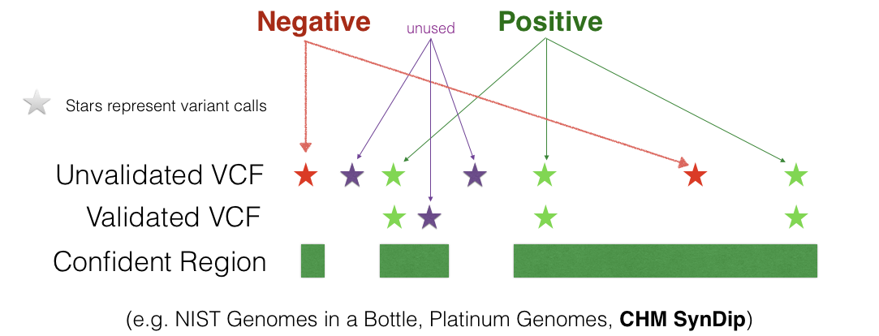
Generate Training Data: Compare New VCFs to Validated VCFs
Notes:
Use variant annotations like depth, strand bias, count of mapping quality 0 reads spanning that site
For example if we made a scatter plot of known true and false variants and plotted their depth and strand bias scores, the real variants will mostly fall into a region with low strand bias while the false variants will be outliers of this cluster, scattered outside its perimeter. Although not all true variants will belong to the same cluster – typically there are a handful of clusters and the exact number varies by dataset.
Gaussianly distributed – for each annotation, which are going to be the dimensions of our data, most variants take on some mean value with the values of the other variants being distributed around that mean in the familiar bell shape.
Gaussian mixture model
----
For those models we need truth data. A validated VCF. What is a good or bad variant?
Consensus based: NIST runs lots of var call algorithms (gatk, freebayes) on the same sample and look at where all the calls agreed. This becomes the validated call (ni green)
Where some of the algs had calls and others didn’t, we remove that region from the confident VCF and exclude the variant.
Good to get high quality data. But its kind of bad because we only focus on all the things that are easy to call and everyone does.
Platinum Genomes brought in a pedigree of large family from Utah with extensive pedigree information and they were able to look at not just consensus but also mendelian violations across different var call systems. The ones that violated, remove them from the VCF.
(Need to make the graphic more clear. Lee or Sam could help)

Slide 9
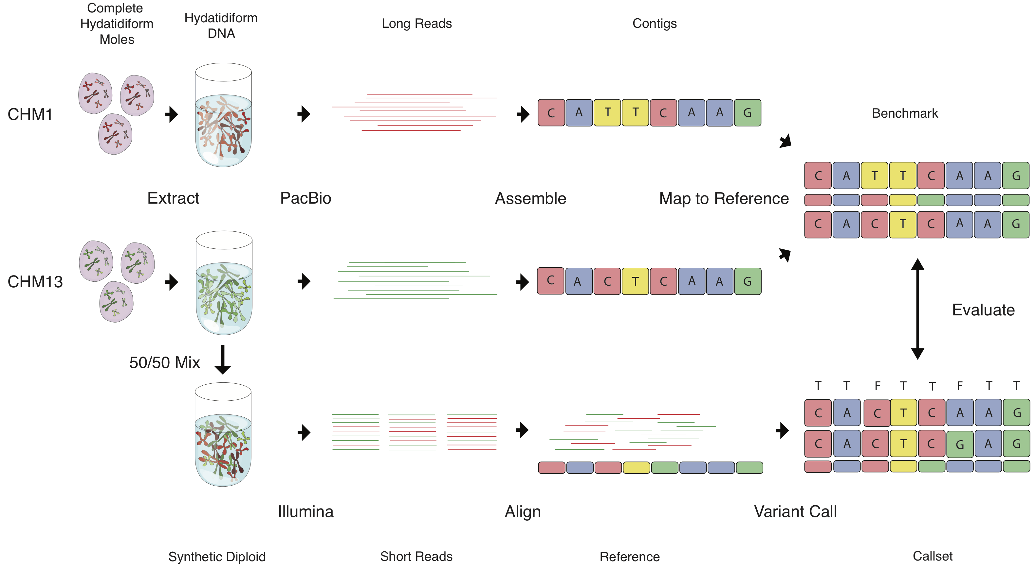
Making High Quality Training Data Requires Creativity
Notes:
Start with the Mole. Mole = egg that has no DNA. Fertilized by sperm. Sperm DNA duplicates and grows tissue. The tissue is haploid (no DNA from egg). Human genome but only haploid so much easier to cal since there are not heterozygous sites. This tissue was sequenced and it was done with long read dna sequencing technology. Since tissue is haploid, its much easier to call with long range.
From two of these haploid tissues, we were able to create a DIPLOID synthetically. We knew the haplod sequences of each and then construct a heterozygous seeming genome where you know the truth data for each of the parental chromosomes.
Has no dependence on the Illumina technology so an interesting truth set.

Slide 10
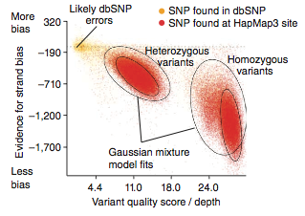
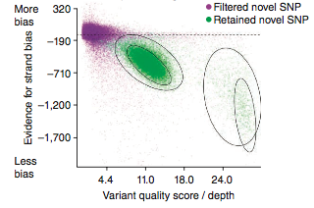
Gaussian Mixture Models for Variant Scoring (VQSR)
Model trained on validated VCF
Model applied to new SNPs
Modified from DePristo et al. Nature Genetics. 2011
Fit Gaussians in annotation space to positive and negative variants
Notes:
(I don’t think we use strand bias anymore)
This is just a projection into 2-D space for these two variation, but the VQSR uses all the annotations that you give it.
You may be wondering “why do I have to do this for every dataset? Can’t I just use the classification rules from the first dataset on all my other projects?” Nope! Different experiments and different data have different fits, from batch effects, etc. Need to retrain every time for best results.
Need to start with high confidence variants like HapMap.
-----
First model avail. Is the VQSR:
Based on Gaussian mixture models.
Annotation space in 2D. This space is as big as the # of annotations that you wish to use. Typiocally 7-9 dimensional space (read pos, rank sum, depth. Etc)
Combine annotations of choie and the model fit gaussians on the variatns based on the truth model
Then you get what is leftover but fit more gaussians onto that.
To determine if a new variant is real or artifact – does it fit inth te nice blobls or in the leftover gaussian blob that described all the remains?
What are the shortcomings?
Annotations are assumed to fall into the gaussian blobs. Sometimes this happens but often the values, mapping quality, is arbitratily cut off at 60. You wont see a blob – a hard edge at 60 so then when you try to fit that model you get problems.
Negative data is just “everything else” and its much harder to describe that with a nice gaussian blob.
Red = actual dataset – everything from the actual dataset that was also seen in a validated VCF. Most variation is common.
Gaussians are fit on your dataset but ONLY around the ones that are also seen in the VALIDATED VCF
Yellow= fit for variants seen in your VCF but NOT in the validated VCF
Score = ratio between red and yellow.
How do you choose how many gaussians to fit? Hyperparameter: we offer defautls but if you git too many the tool will crash. Smaller callsets may mean smaller number of gaussians.
Another thing to notice is that we are just using the annotation values.

Slide 11
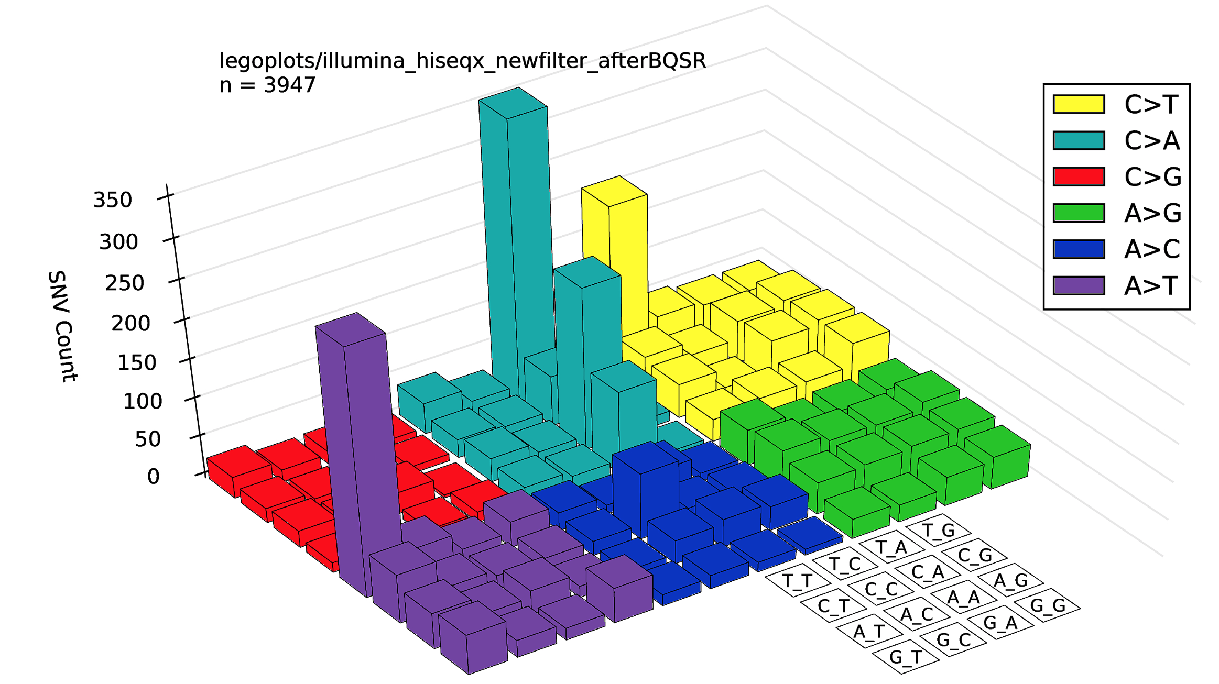
DNA Sequence Context Matters
Notes:
We leave some information on the table such as DNA sequence in the previous version of filtering with VQSR.
Colors indicate what mutation was at particular site.
The boxes within each color indicate what the neighboring base was on each side of that point wise mutation.
Big purple tower.
A > T SNP surrpunded by 2 Ts.
Homopolymer region whish is notoriously hard to sequence. Many errors in context like this so we want ot use this information into the model

Slide 12
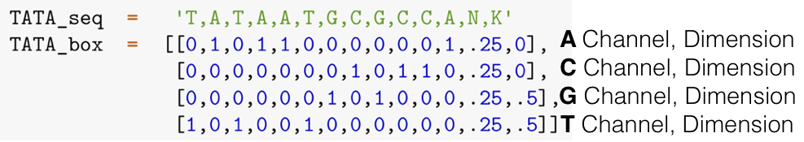
Encode DNA from the Reference Sequence as 1-Hot Tensor
Notes:
Get into NUMERICAL significance.
Tensor encoding. Take sequence of DNA and replace it with matrix with 4 rows and as many cols as there are positions in the genome that we want to look at.
Call cols “channels”
Can encode ambiguity like N which can be any base.

Slide 13
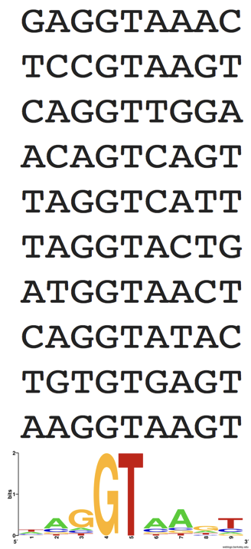
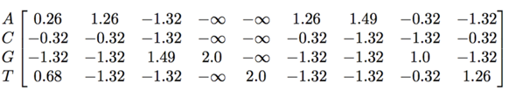
The Position Weight Matrix
Multiple
Sequence
Alignment:
Consensus Sequence:
010001100
000000000
001100010
100010001
Consensus throws away valuable information.
Tyranny of the majority!
Position Weight Matrix:
Notes:
Now we operate the encoded reference from the previous state.
Position weight matrix. Look at multiple sequence alignment (left). Notice that conservation is distributed. Parts of seq that are more conserved than other parts.
Take majority at each position but tons of information gets throw away fi you do that. You cant see that the GT are much more important than the surrounding bases. Replace the 1/0s with floating point values that are more representation of our expectation of seeing that base at that site.

Slide 14
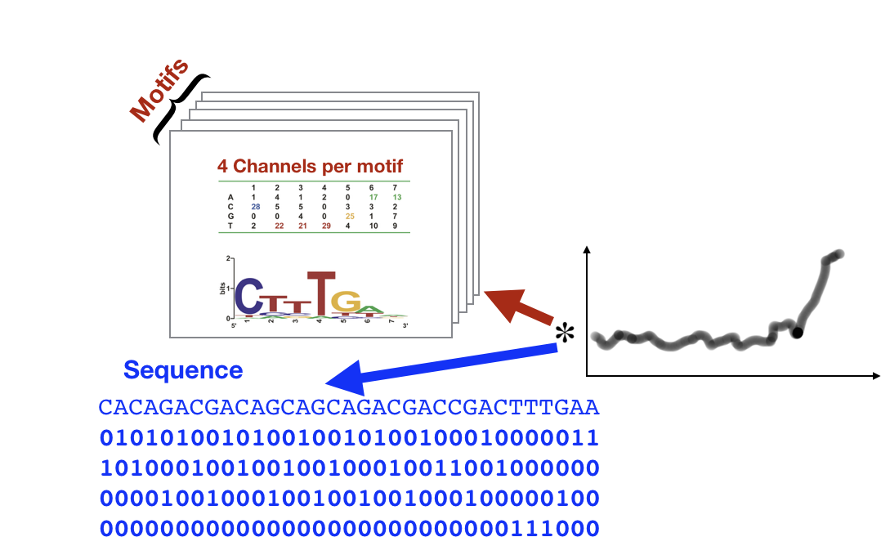
Convolution with Position Weight Matrix is Motif Detection
Notes:
With this pos weight sequence we can look for sequence.
Convolution.
Sequence and Motif. Same as detecting MOTIFS but defined with mathematical operations.

Slide 15
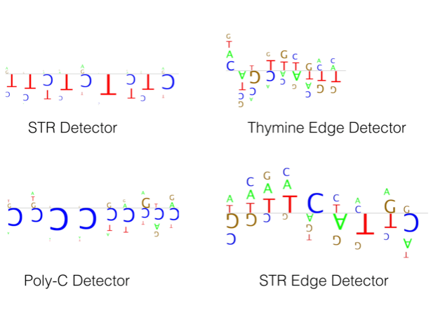
What does it Learn?
Notes:
We used to observe the multiple sequence alignments and observing which sites were more conserved than others.
With truth data we can learn the motifs dynamically with the data at hand. We are reassured with the motifs that we’ve already know were important
The homopolymers are difficult to call. Common motif that we see are homopolymer detectors with the model. Lots of Cs? Probs more likely to have errors.
Short tandem repeats are also seen in the Motif.

Slide 16
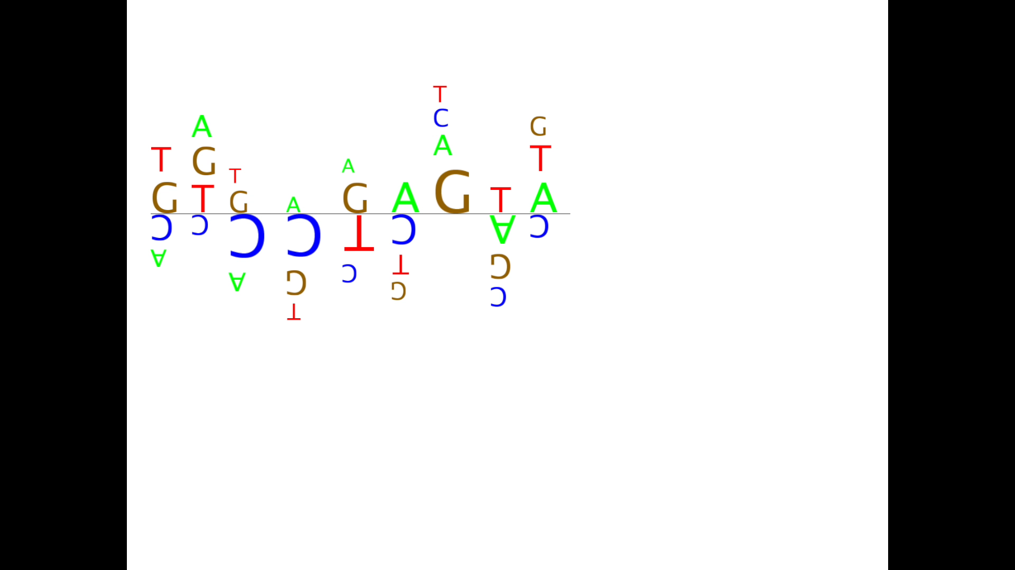
What does it Learn?
Notes:
Positives are more likely to be a true variant
Negatives are more likely to be an artifact

Slide 17
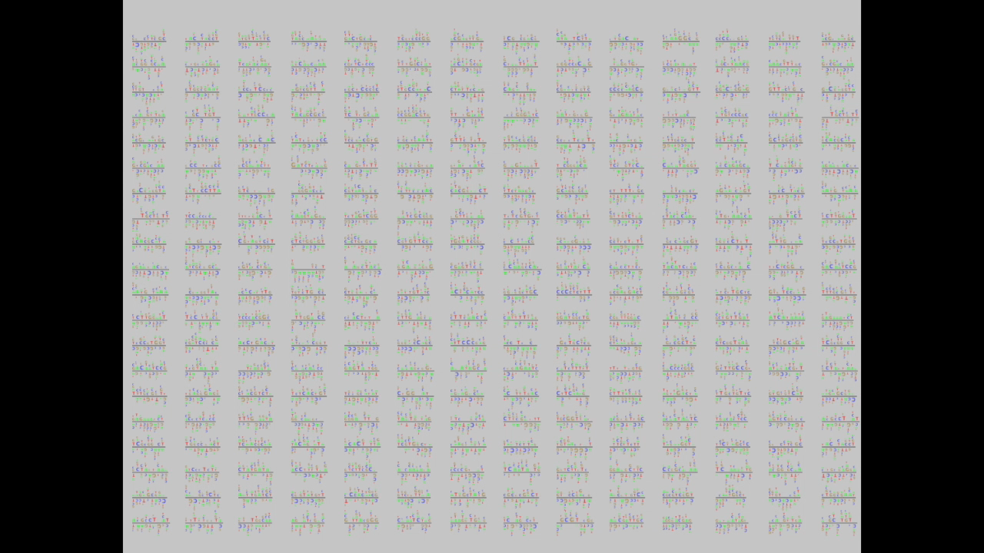
What does it Learn?
Notes:
We learn lots of these motifs in parallel.
We are doing these steps on the validated data and then compare on the new dataset.
All things that overlap are true and things that are not in the validated file are false.
The learning model is training to distinguish between the two.
1D model

Slide 18
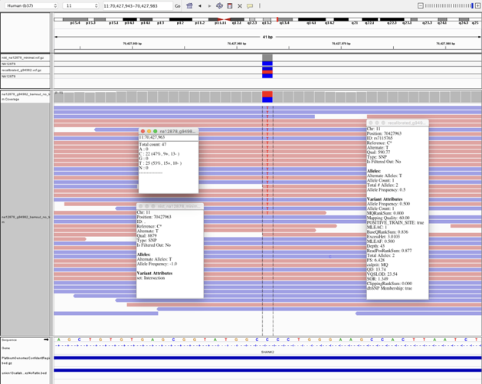
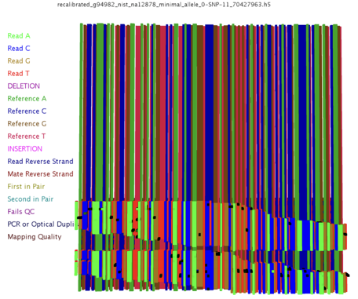
Encoding the reads
Notes:
Now we have seen sequence context
But what about the other information we left behind?
2D model. More powerful but slower.
This model also brings in the raw read data. We only looked at sequence context but now adding reads too.
HET SNP. In RED are Ts and the Ref is C
Different color of reads shows strand. Can see where on the read the SNP is and each base also contains quality.
Take all the information and encode it in the read tensor. Its not a 2D matrix but it’s a 3D tensor. Sequence information from the reference and ALL th reads as well as base quality and other additional information/

Slide 19
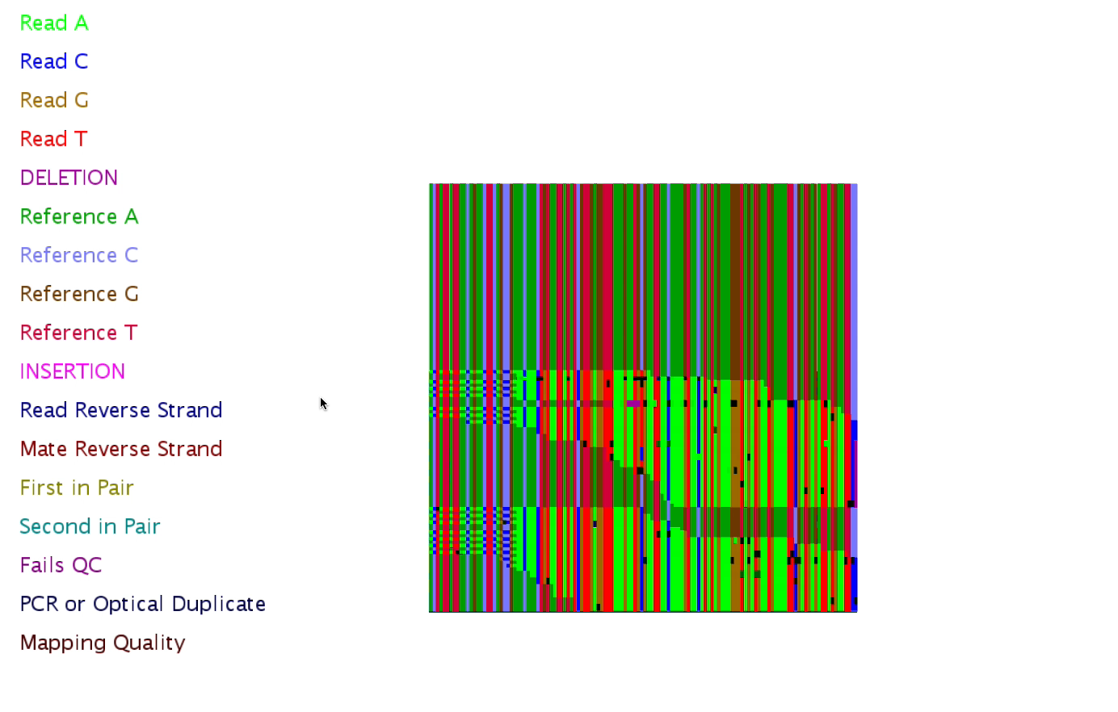
The Read Tensor
Notes:
Were seeing the difference channels (before they were ACTG) and now we have channels for read metadata as well as sequence context.

Slide 20
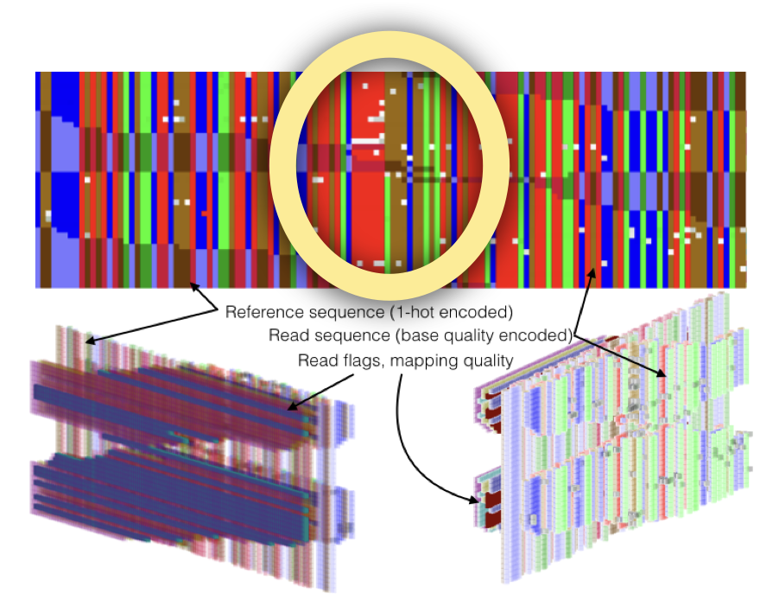
G to A SNP with Surrounding Context
Notes:
SEE a G > A SNP. The brown is the G and

Slide 21
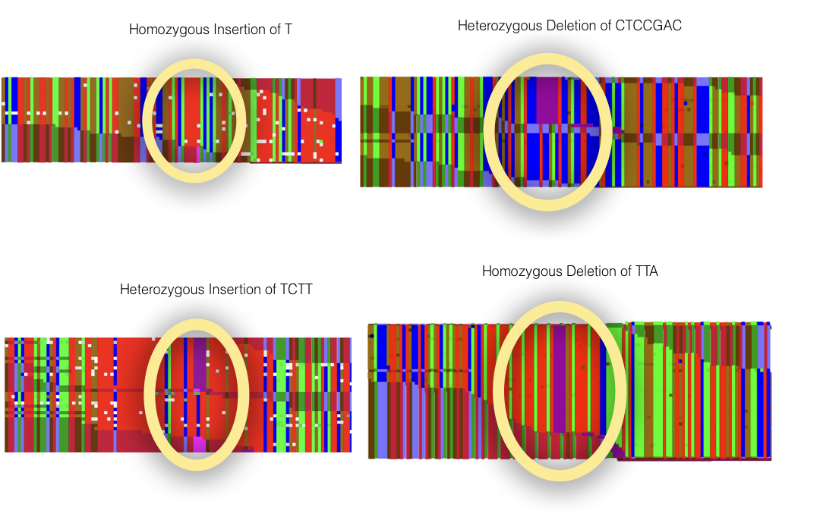
The Read Tensor: INDELs
Notes:
Homozyg insertion of T. all the samples have the T but the Ref doesnt

Slide 22
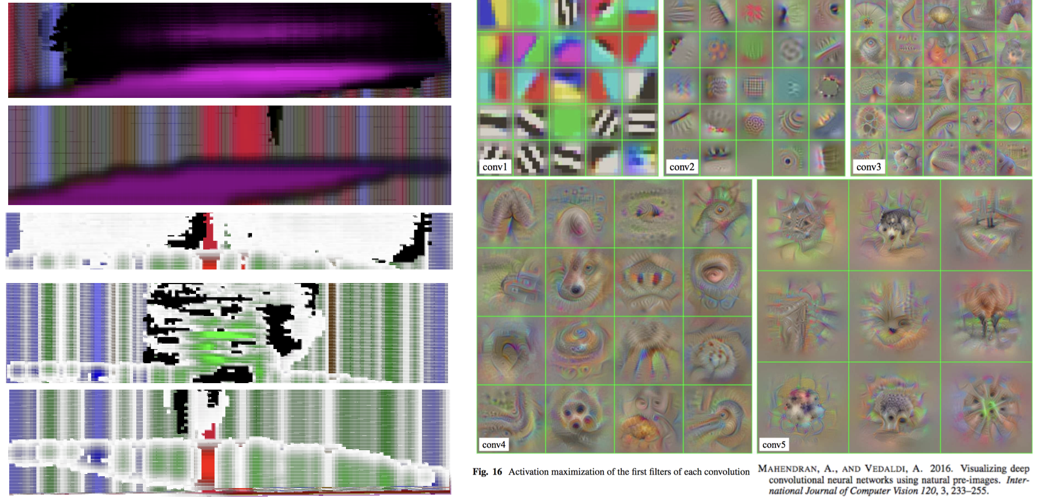
Deep 2D Convolutions Learn Abstract Heirarchy of Motifs
Notes:
Now we are goong to build many layers on top of the first motif detectors. Look at motifs in raw data and then we look at them together.
Look at images to expain since its easier to understand.
In early layers of images we extract edge detectors. Promitive features for all kinds of visual tasks. What are the boundaries.
Then look at patterns
Then look at textures
Then object parts
Then details like textures

Slide 23
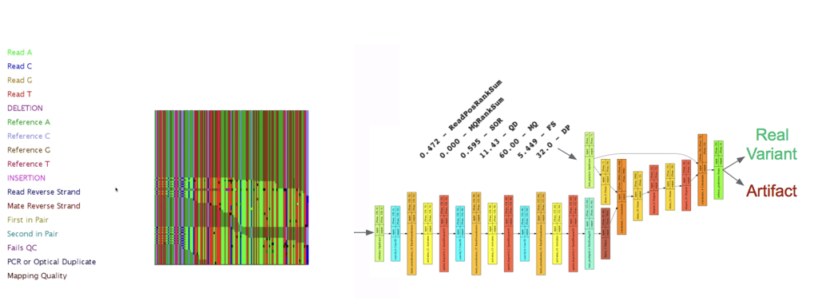
Putting it all Together: CNNVariant
Notes:
Note that the pictures used here are just to give a general idea of what each step is doing, they’re not meant to directly illustrate tool output.
Very important to explain: VR does both the training and applying the model to the callset. AR is a misnomer, really it applies the filter, not the recalibration itself.
---
Oput it all together into the model
Read tensor with reads and sequence context
Bring in annotations
At the end we say is it a real variant or articact based on real validated data

Slide 24
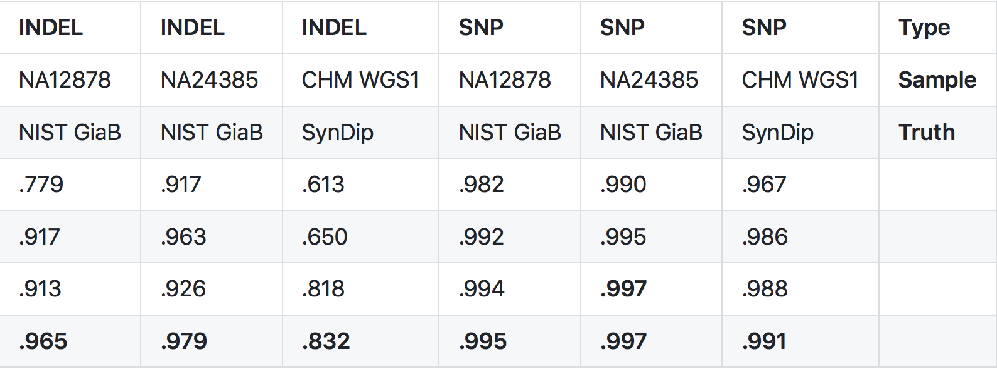
Deep learning : a New Frontier in Genomics
Area under Precision-Recall Curve
INDEL
SNP
TYPE
Architecture
VQSR 1-sample
VQSR gnomAD
Deep Variant
GATK4 CNN
Convolutional Neural Networks
Notes:
Compare with other approaches
How is our sensitivity and precision.

Slide 25
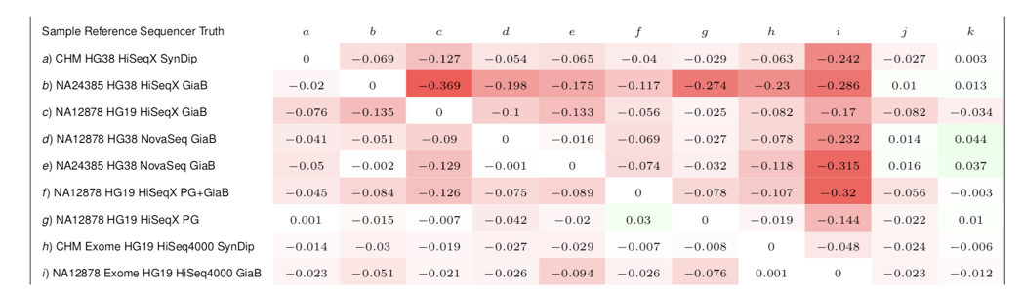
Cross Generalization
GATK 4.1 Deployed Model for Single Sample Variant Filtration!
Notes:
How does this generalize across datasets.
Exomes v genomes
Hg38 v hg 19
Diff sequencers
J =
K = A-I (check this)
See a generalization across data modalities

Slide 26
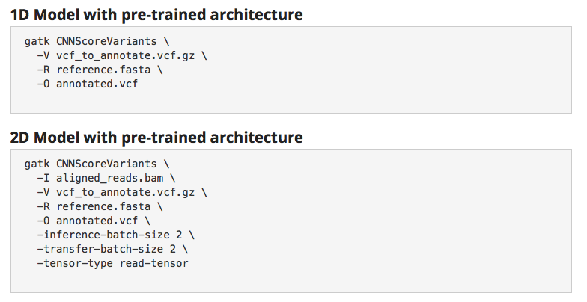
Two Ways to Score Variants
1D Model uses:
Variant Annotations
Reference
2D Model uses:
Variant Annotations
Reference
Read Information
Notes:
Tool is 2 parts
Score variants which adds field with score

Slide 27
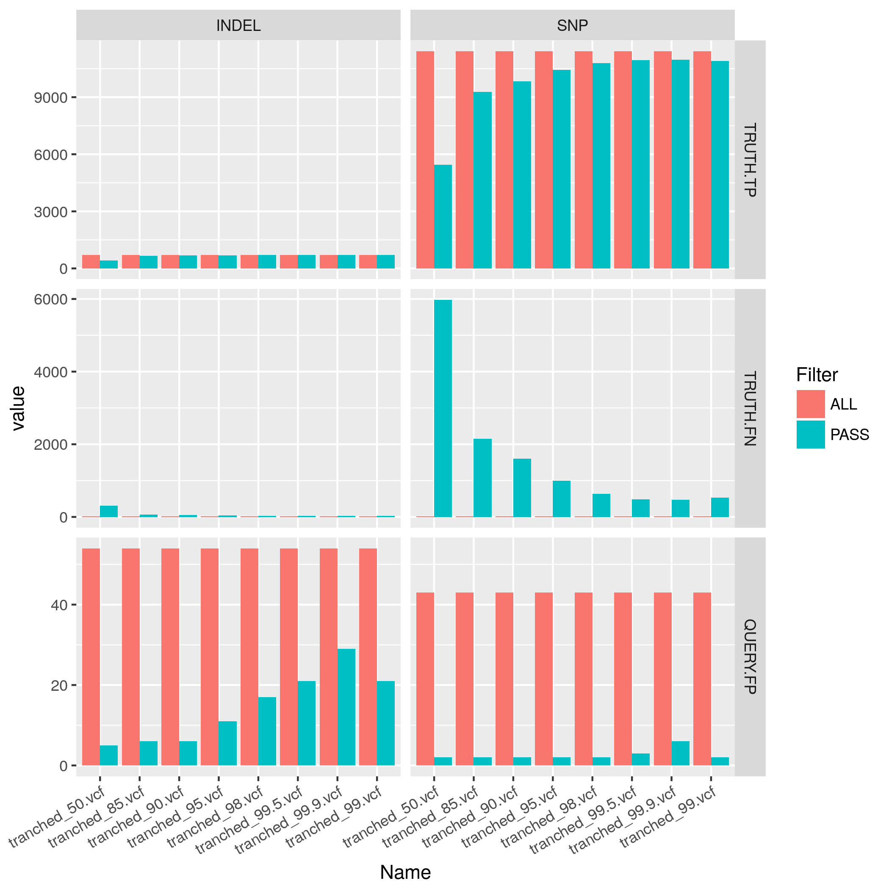
Filter Variants with FilterVariantTranches
./gatk FilterVariantTranches
-V my_2d_cnn_scored.vcf
--resource 1000G_omni2.5.b37.sites.vcf
--resource hapmap_3.3.b37.sites.vcf
--info-key CNN_2D
--snp-tranche 99.9
--indel-tranche 99.5
-O my_2d_filtered.vcf
--invalidate-previous-filters
Notes:
Filter variants which lets user set a threshold and filter variants based on that cutoff value.

Slide 28
Best Practices for Germline SNP & INDEL Discovery
Notes:
Are all the layers that are used convolutional layers?

